Slide 1
Slaviša Đurđić
London Crime
Goal: Analysis of the London crime dataset for period 2014-2016.
Instructions:
- Collect data from the "bigquery-public-data.london_crime.crime_by_lsoa" dataset available on BigQuery.
- Load the data to MySQL table(s).
- Execute some basic SQL queries to get first insights about the data.
- Build visuals in Power BI Desktop.
- Test hypothesis.
Belgrade, August 2023

Slide 2
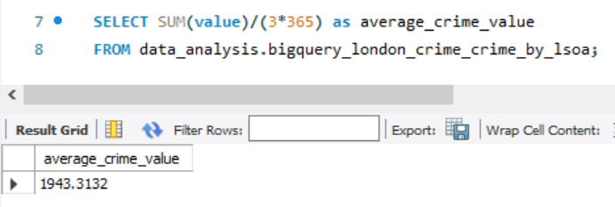
MySQL queries
Daily average crime rate for period 2014-2016:

Slide 3
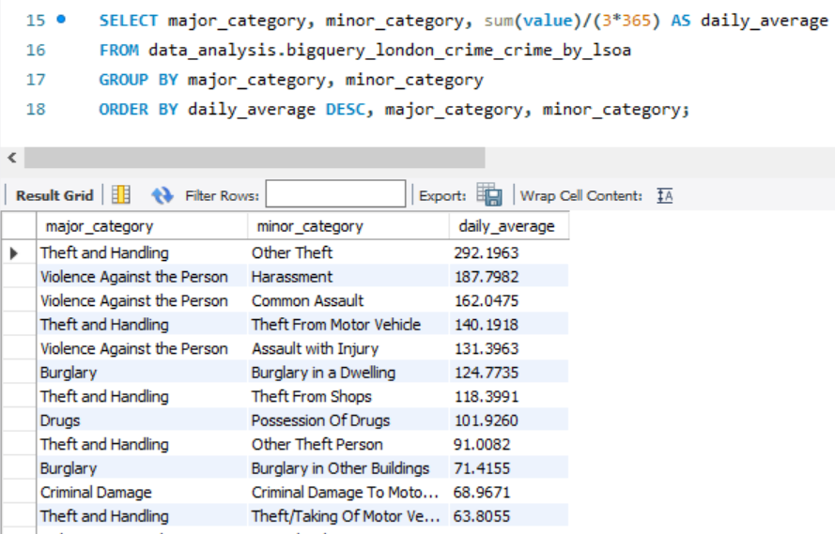
MySQL queries
"Theft and Handling" and "Violence Against the Person" make the top crime major categories by daily average number of crime:

Slide 4
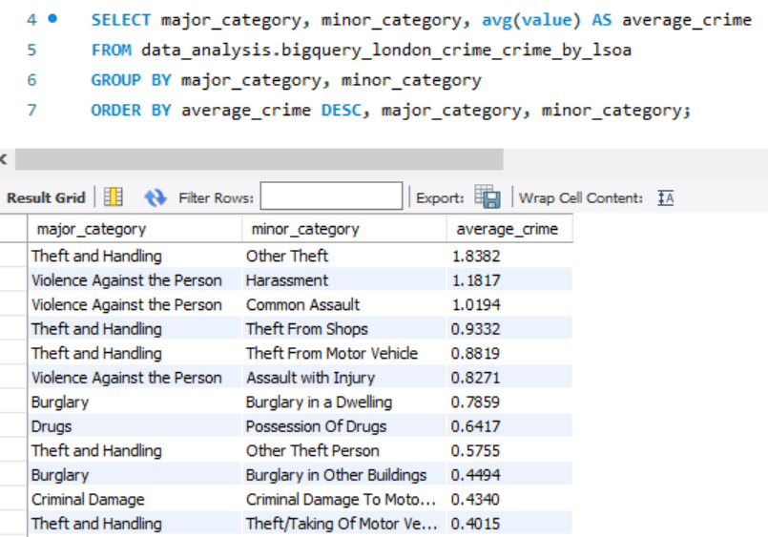
MySQL queries
"Theft and Handling" and "Violence Against the Person" make the top crime major categories by average number of crime:

Slide 5

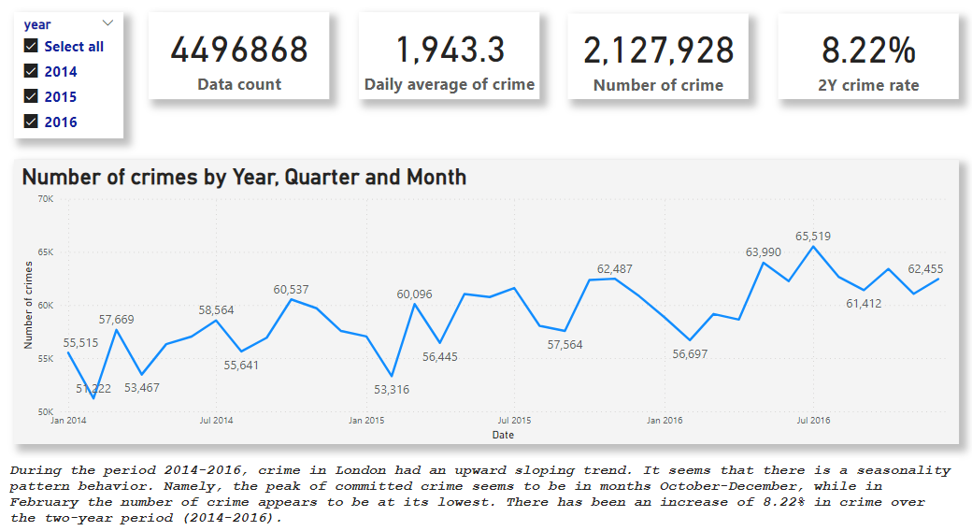
Microsoft Power BI

Slide 6
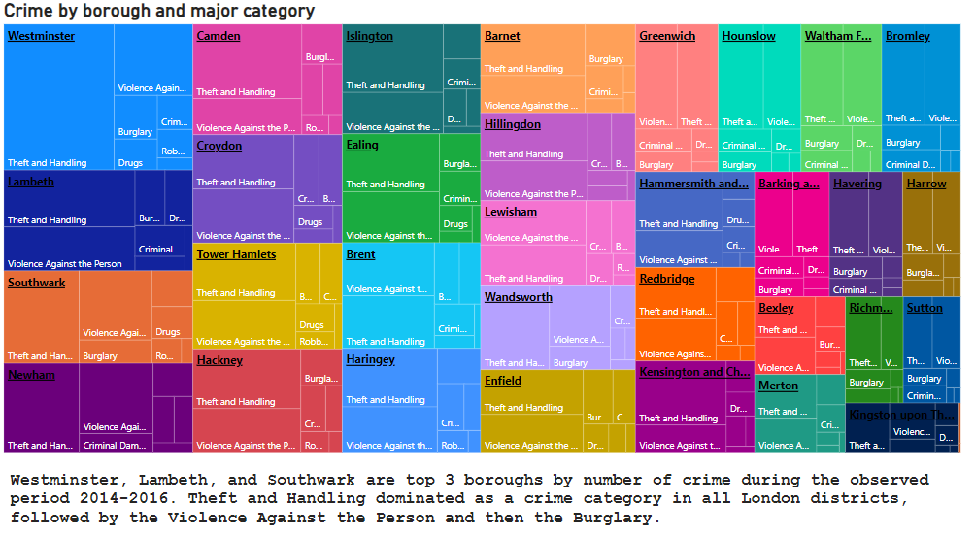
Microsoft Power BI

Slide 7
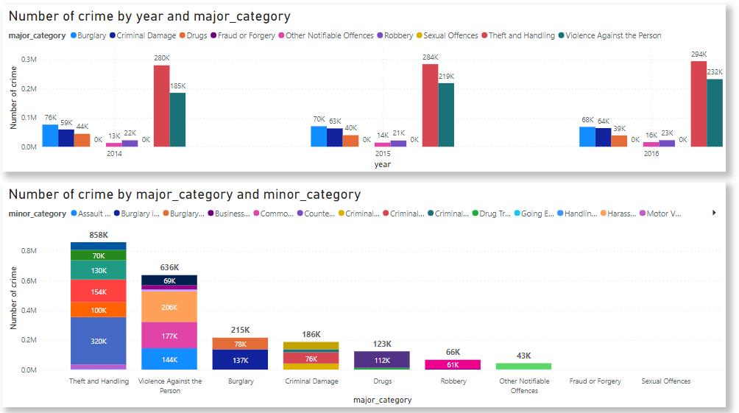
Microsoft Power BI

Slide 8
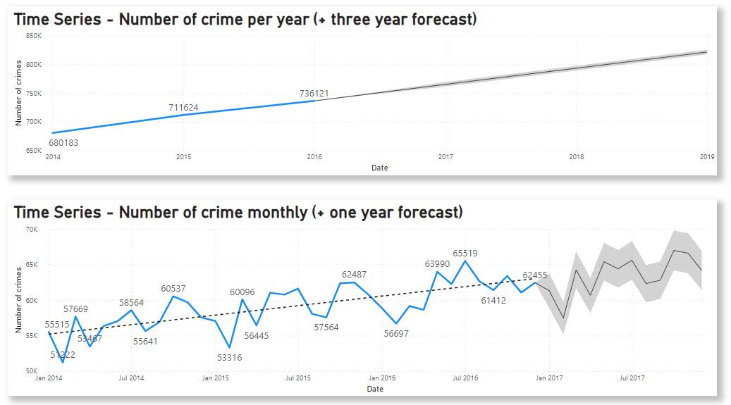
Microsoft Power BI

Slide 9
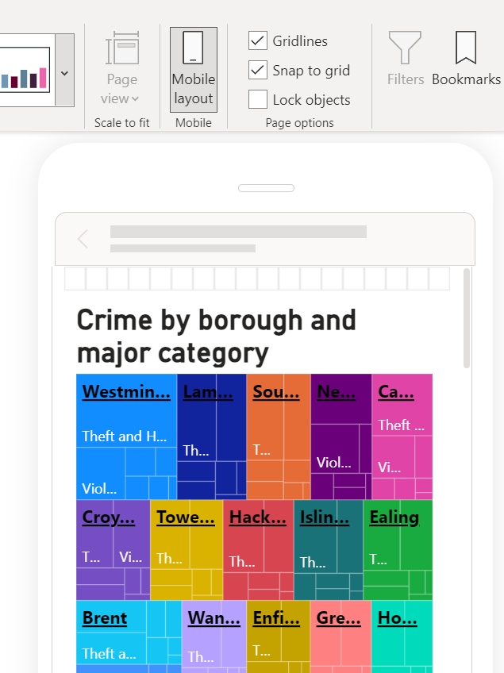
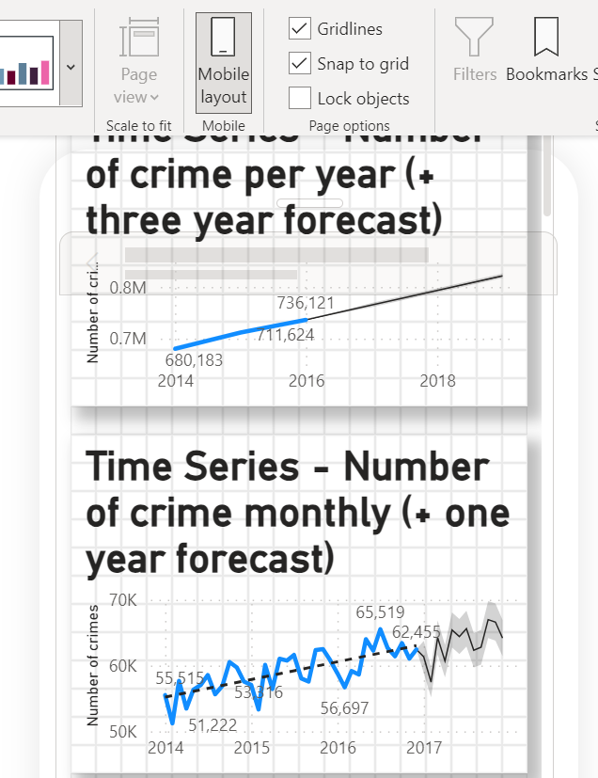
Microsoft Power BI

Slide 10
London Crime Project Insights
1) During the period 2014-2016, crime in London had an upward sloping trend. The 2-year crime rate was 8.22%.
2) It seems that there is a seasonality pattern behavior. Namely, the peak of committed crime seems to be in months October-December, while in February the number of crime appears to be at its lowest.
3) Westminster, Lambeth, and Southwark are top 3 boroughs by number of crime during the observed period 2014-2016.
4) Theft and Handling dominated as a crime category in all London districts, followed by the Violence Against the Person and then the Burglary.
5) Based on a hypothesis testing that I performed, with a confidence level of 95%, we can’t reject the hypothesis that the mean value of committed crime in Westminster is higher than the mean value of committed crime in Lambeth borough.

